Slide 1
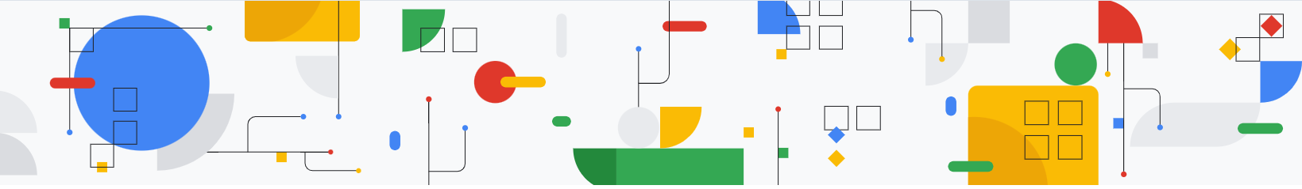
AI Agents
:- Harsh Dalal

Slide 2
What are AI Agents?
AI Agents are autonomous systems or software entities that observe, reason, make decisions, and act on behalf of a user or system to achieve specific goals.

Slide 3

AI Agents
Key Features of AI Agents:
  Can sense (take input)
  Can reason or plan (internal logic or model)
  Can act (interact with environments, tools, APIs)
  May learn or adapt over time
  Often operate autonomously or semi-autonomously
Think of them as smart assistants on steroids, capable of multi-step, intelligent action with minimal human input.

Slide 4
AI Agents vs
LLMs

Slide 6
Advantages of AI Agents
Autonomous Task Execution
Can perform tasks end-to-end with minimal human oversight(e.g., market monitoring, customer follow-ups).
Goal-Oriented Reasoning
Not just reactive—agents can plan, evaluate, and adapt toreach a target state.
Integration with Tools & APIs
AI Agents can use calculators, databases, CRMs, browsers,etc., to get real work done.
Efficiency & Time Saving
Can automate workflows that would otherwise need manualsteps or scripting.
Adaptability
Can be designed to adapt strategies based on context orfeedback.

Slide 7
Disadvantages of AI Agents
Complex Setup & Maintenance
Requires orchestration, environment configuration, andsometimes custom toolchains.
Unpredictable Behavior
Autonomy introduces risk—agents can take wrong orunintended actions if not properly bounded.
Debugging is Hard
Multi-step, dynamic behavior makes tracing errors difficult.
Security Risks
Especially if agents can perform actions (e.g., makepurchases, send messages).
Computational Overhead
Running agents with memory, planning, and external toolscan be resource-intensive.

Slide 8
Core Components of AI Agents
:- Harsh Dalal

Slide 9
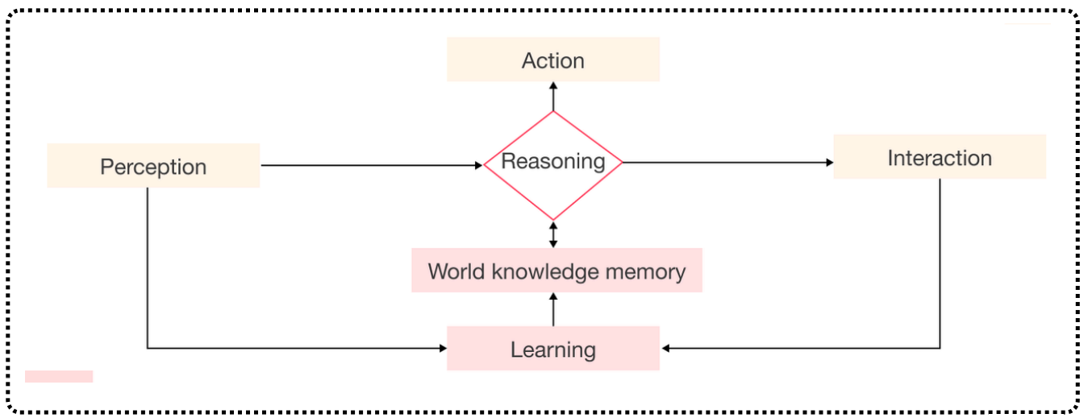
Core Components of AI Agents

Slide 10

Perception (Sensing the Environment)
This is where the agent gathers data from the outside world. Depending on the environment and application, this can include:
Human input (text, voice, clicks)
Camera or visual data (for computer vision agents)
Sensor readings (like in robotics or self-driving cars)
APIs or digital environments (for software agents)
Basically, this is the agent’s “eyes and ears”—it’s how it knows what's going on

Slide 11
Knowledge Base (What the Agent Knows)
This is the internal memory or world model that the agent uses to make sense of its environment. It can be:
Pre-programmed facts or logic rules
Learned models from data (e.g., neural networks, decision trees)
Ontologies or knowledge graphs (structured semantic data)
Context memory (in LLMs and task agents)

Slide 12
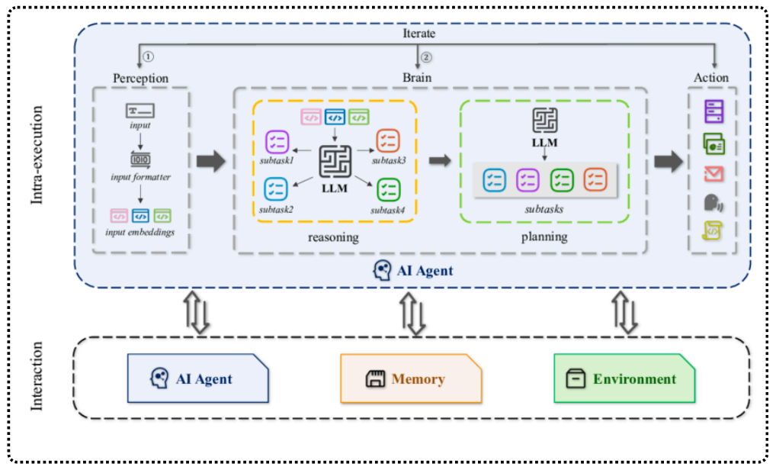
Core Components of AI Agents

Slide 13
Reasoning/Planning
Once the agent knows the situation, it needs to decide what to do next. This is where logic, learning, and sometimes search algorithms come in.
Rule-based reasoning (IF-THEN logic)
Search algorithms (like A* , DFS, etc. for path finding)
Goal-based planning (deciding steps to reach an outcome)
Reinforcement learning (learning what actions yield rewards)
This part is like the strategist brain of the agent—analyzing, weighing options, and planning.

Slide 14

Learning (Getting Smarter Over Time)
Good agents don’t just act—they improve.
Learning can be:
Supervised (learning from labeled data)
Unsupervised (finding patterns on its own)
Reinforcement (learning through trial and error)
This is how agents become more effective and adapt to new environments or challenges.

Slide 15
Actuation (Doing the Thing)
This is how the agent interacts with the world.
Robots move, grab things, navigate
Chabot's send messages or speak
Software agents trigger actions, run code, or manipulate data
It’s the “hands and mouth” of the agent—how it executes its decisions.

Slide 16
Feedback Loop (Learning from Outcomes)
Finally, smart agents check if their actions worked and update accordingly.
Did the action succeed?
Did it fail?
Did it improve the state of the environment?
This feedback fuels learning and helps the agent refine its behavior

Slide 17
Putting It All Together
The flow looks something like this:
Perceive → Understand → Plan → Decide → Act → Learn → Repeat
Every AI agent—whether it’s a chatbot, game bot, robot, or task automation tool—relies on some version of this cycle.

Slide 18
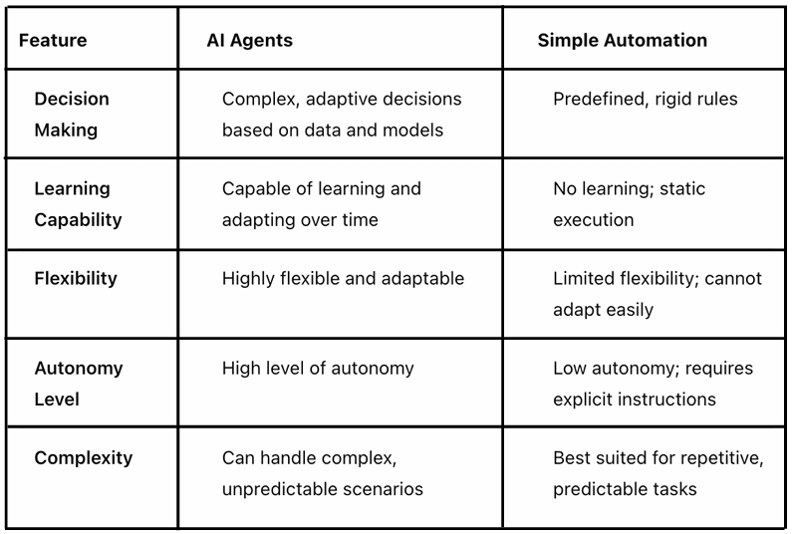
AI Agents Different from Simple Automation?

Slide 19


Any question

Slide 20

Thank you

